Slide 1
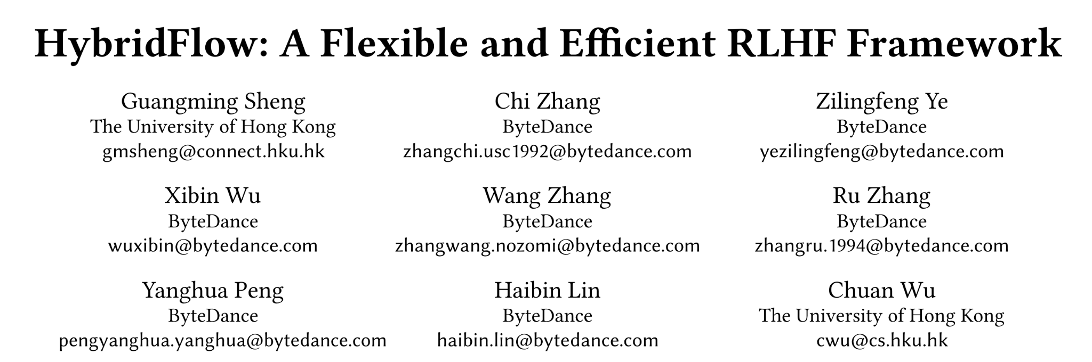
Presentation: Shouwei Gao Date: May 20 2025

Slide 2
Overview
Reinforcement Learning from Human Feedback (RLHF) is crucial for Large Language Model (LLM) alignment.
Traditional RL dataflows are complicated by RLHF, where nodes become distributed LLM programs and edges are many-to-many multicasts.
Existing single-controller RL frameworks are inefficient for RLHF due to high dispatch overhead; multi-controller systems can be inflexible.
HybridFlow is proposed: Combines single and multi-controller paradigms for flexible representation and efficient execution of RLHF dataflows.
Features hierarchical APIs for decoupling computation and data dependencies.
Includes a 3D-HybridEngine for efficient actor model resharding with zero memory redundancy and reduced communication.
Experimental results show 1.53×~20.57× throughput improvement over baselines.

Slide 3
2. Introduction- Large Language Models (LLMs)
LLMs (e.g., GPT, Llama, Claude) have revolutionized AI applications (writing, search, coding).
Pre-training: LLMs learn broad knowledge from trillions of tokens via next-word prediction.
Supervised Fine-Tuning (SFT): LLMs are trained on domain-specific datasets to follow human instructions.
Despite these steps, LLMs can still generate toxic or undesirable content due to biases in training data.

Slide 4
2. Introduction - Reinforcement Learning from Human Feedback (RLHF)
RLHF aligns LLMs with human values, creating helpful and harmless AI.
RLHF builds on traditional RL algorithms like PPO and REINFORCE.
A typical PPO-based RLHF system includes four LLMs:
Actor Model
Critic Model
Reference Policy Network
Reward Model

Slide 5
2. Introduction - PPO-based RLHF Iterative Stages
PPO-based RLHF proceeds in iterations, each with three main stages:
Response Generation: Actor model generates responses to prompts.
Data Preparation: Generated responses are scored by critic, reference policy, and reward models (single forward pass each).
Learning/Training: Actor and critic models are updated based on human preferences (forward/backward computation).
Other RLHF variants (e.g., Safe-RLHF, ReMax) follow similar stages with different models/dependencies

Slide 6
2. Introduction - The Challenge: Complexity of RLHF Dataflow
Traditional RL can be modeled as a dataflow with nodes as NNs and edges as data dependencies.
RLHF dataflow is more complex:
Nodes are distributed LLM programs (actor, critic, etc.) performing distinct computations (training, generation).
Models in different nodes often use different parallelism strategies.
Edges represent data resharding, often complex many-to-many multicasts.
This necessitates flexible representation and efficient execution.

Slide 7
2. Introduction - Limitations of Existing Approaches
Traditional RL Frameworks (Single-Controller):
Central controller manages dataflow.
Inefficient for RLHF due to large control dispatch overhead for distributed LLM computation.
Often limited to smaller NNs and data-parallel training.
Existing RLHF Systems (Multi-Controller):
Each device/node has its own controller.
Low dispatch overhead for LLM computation.
Inflexible: Modifying data dependencies requires changes in multiple nodes, hindering code reuse. Computation and data dependencies are often nested.

Slide 8
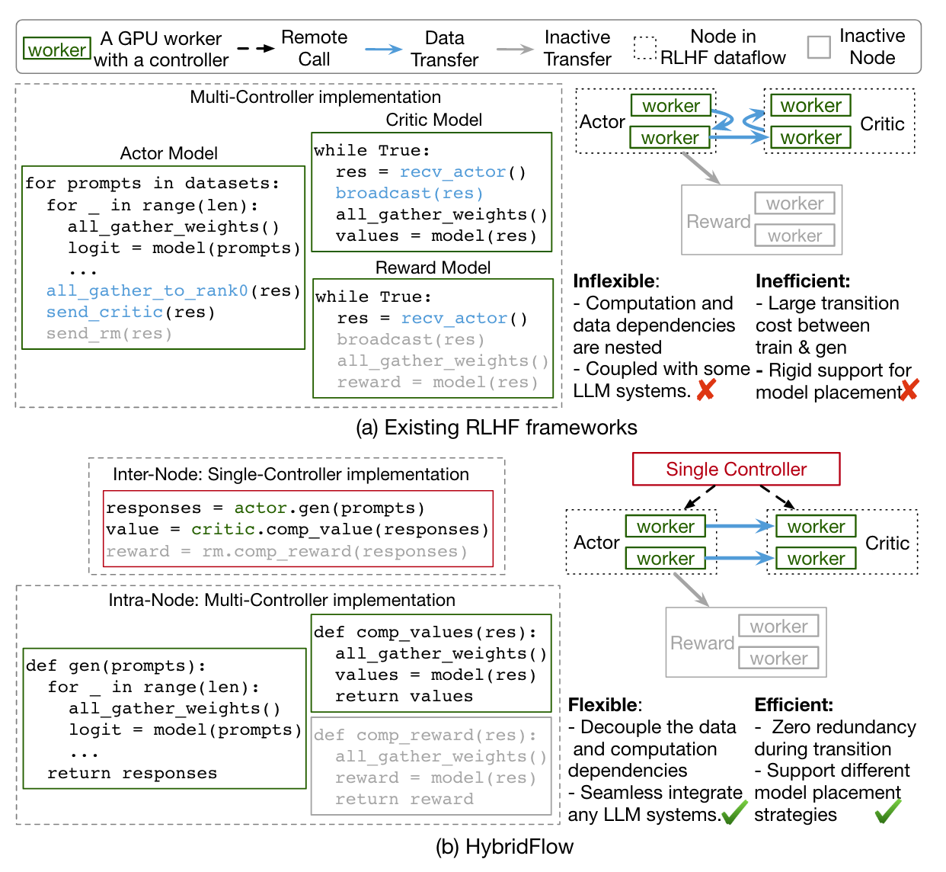
Introducing HybridFlow: A Hybrid Solution
Key Idea: Combine single-controller and multi-controller paradigms.
Inter-Node (Single-Controller): Flexible expression of data dependencies and coordination of data resharding with minimal overhead.
Intra-Node (Multi-Controller): Enhances computation efficiency for distributed LLM tasks.
Hierarchical APIs: Decouple and encapsulate computation and data dependencies.
3D-HybridEngine: Efficient actor model resharding between training and generation phases (zero memory redundancy, reduced communication).

Slide 9
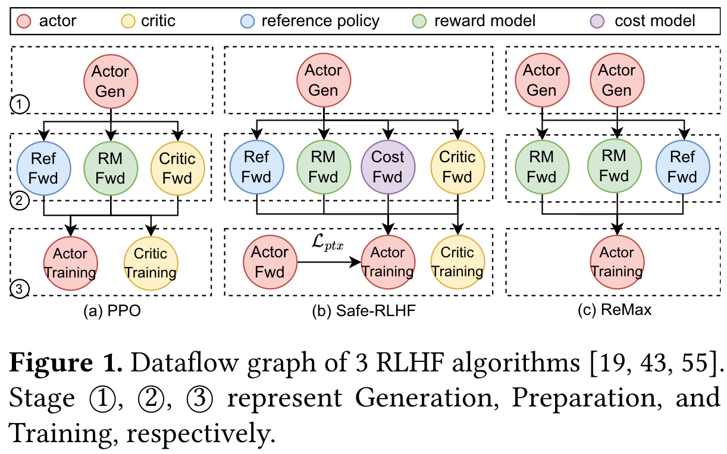
3. Background: RLHF Workflow & Algorithms
RLHF aligns LLMs using human-ranked responses.
Typical system: actor, critic, reference policy, reward model(s).
PPO Example Workflow (3 Stages):
Generation: Actor produces responses.
Preparation: Critic, reference, reward models score responses.
Learning: Actor and critic are updated.
Variations exist (e.g., Safe-RLHF, ReMax).

Slide 10
3. Background: Parallelism Strategies for LLMs
LLMs utilize various parallelism types for training and serving:
Data Parallelism (DP): Input data split across devices, each with a model replica.
ZeRO: Memory-optimized DP, shards optimizer states, gradients, parameters.
Pipeline Parallelism (PP): Model layers split across devices.
Tensor Parallelism (TP): Individual tensor operations split across devices.
3D Parallelism (PP, TP, DP combined): Used in modern frameworks like Megatron-LM.
RLHF models have distinct computations (training, inference, generation) and can benefit from different optimal parallelism strategies.

Slide 11
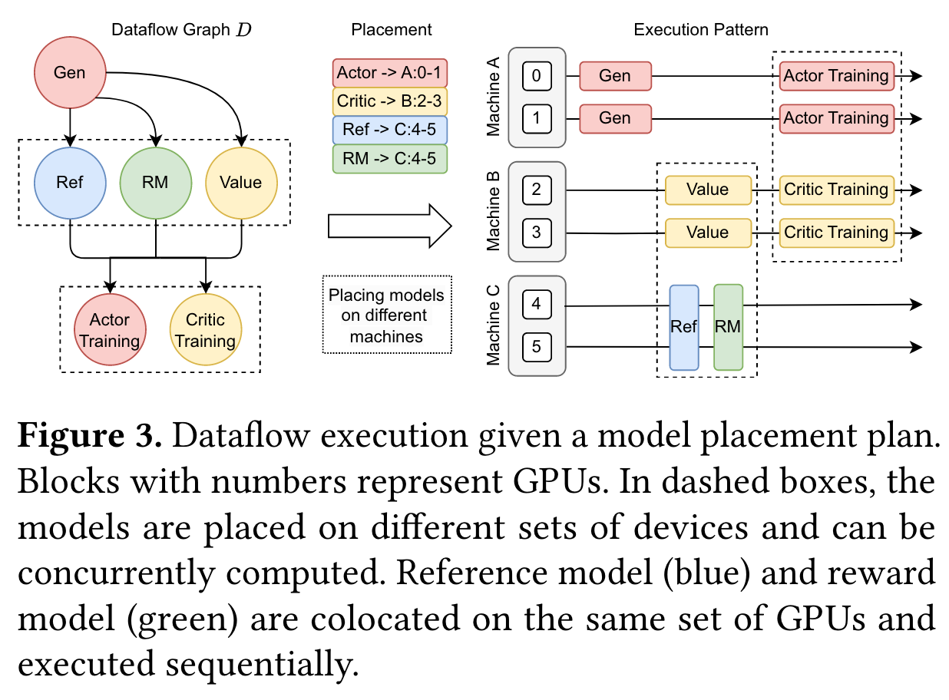
3. Background: RLHF Characteristics & Placement
Heterogeneous Model Workloads: Actor, critic, reference, reward models have different computation and memory needs (training vs. inference vs. generation).
Unbalanced Actor Computation: Training (compute-bound) vs. Generation (memory-bound) benefit from different parallelism. Resharding can be costly.
Diverse Model Placement Requirements:
Models on different devices: parallel execution possible, but potential GPU idle time.
Models co-located on same GPUs: share memory, sequential execution.

Slide 12
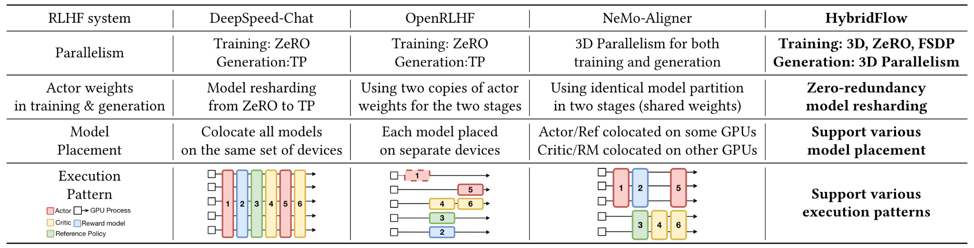
3. Limitations of Existing RLHF Systems Summarized
Inflexible Support for Various RLHF Dataflows:
Multi-controller paradigm leads to mixed code (communication, computation, transfer), making systems tightly coupled with specific LLM frameworks.
Difficult to implement and optimize different RLHF dataflows; hinders code reuse.
Inefficient RLHF Execution:
Suboptimal parallelism for actor training/generation (e.g., OpenRLHF: redundant copies; DeepSpeed-Chat: resharding overhead; NeMo-Aligner: low generation throughput).
Limited to one model placement plan, leading to inefficiencies.

Slide 13
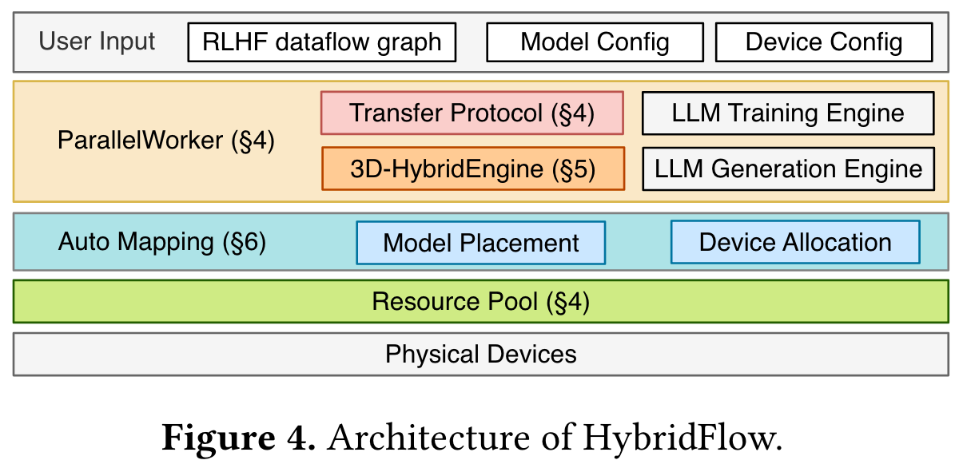
4. HybridFlow System Architecture
User Inputs: RLHF dataflow graph, Model Configuration, Device Configuration.
Major Components:
Hybrid Programming Model (§4): Hierarchical APIs (ParallelWorker, Transfer Protocol).
3D-HybridEngine (§5): For efficient actor training/generation.
Auto Mapping (§6): Model Placement, Device Allocation.
Underlying Layers: Resource Pool, Physical Devices.

Slide 14
4. HybridFlow Workflow
User Provides:
Model specifications (architecture, size).
Device placement (from auto-mapping or manual).
Parallelism strategy for each model (e.g., p, t, d for 3D).
Single Controller:
Initializes models and virtualized resource pool.
Dispatches operations/models to devices per placement plan.
Invokes multi-controller functions for distributed computation.
Coordinates data resharding between models using transfer protocols.
Multi-Controller (ParallelWorker):
Constructs parallel groups for each model.
Invokes 3D-HybridEngine for actor, or other LLM engines for other models.

Slide 15
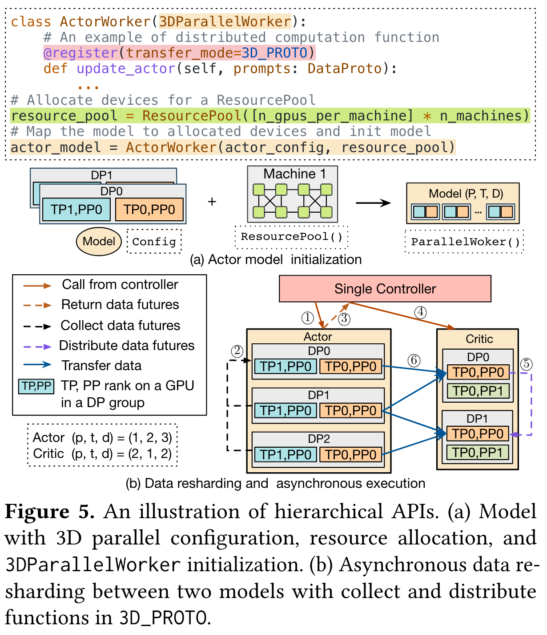
4. Hybrid Programming Model: Hierarchical APIs
Intra-node (Encapsulating Distributed Program):
Base class 3DParallelWorker (also FSDPWorker, ZeROWorker) for distributed computation.
Model classes (e.g., ActorWorker) inherit and encapsulate APIs for forward/backward, generation, updates.
Inter-node (Unifying Data Resharding):
@register associates operations with a Transfer Protocol (e.g., 3D_PROTO).
Protocols have collect and distribute functions for data aggregation/distribution.
Flexible Model Placement: ResourcePool class virtualizes GPU sets for mapping models.
Asynchronous Dataflow Execution: Models on separate devices triggered when inputs are ready.

Slide 16
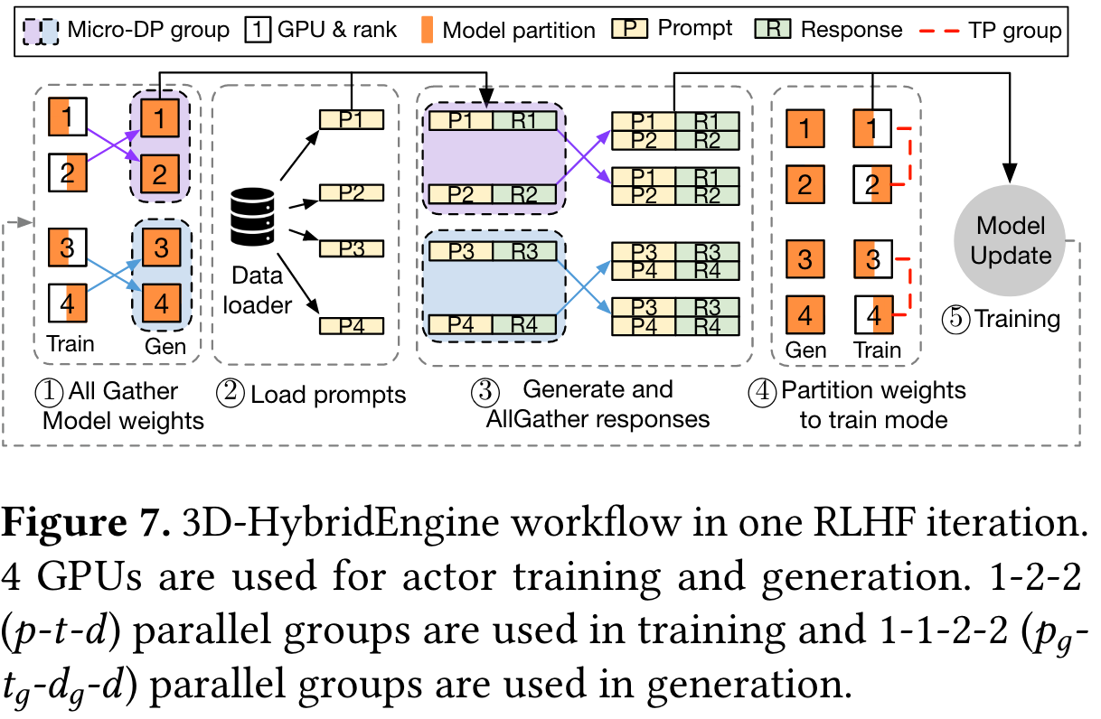
5. 3D-HybridEngine: Efficient Actor Model Handling
Purpose: Efficiently supports actor model training and generation, often the bottleneck.
Deployment: Actor training and generation stages on the same set of devices and same copy of weights to eliminate redundancy.
Different Parallelism: Allows different 3D parallelism strategies for training (p-t-d) and generation (pg​−tg​−dg​−d).
Generation typically uses smaller TP/PP, larger DP (via micro DP groups, dg​).
Workflow: Handles model parameter resharding and data distribution between training and generation phases.

Slide 17
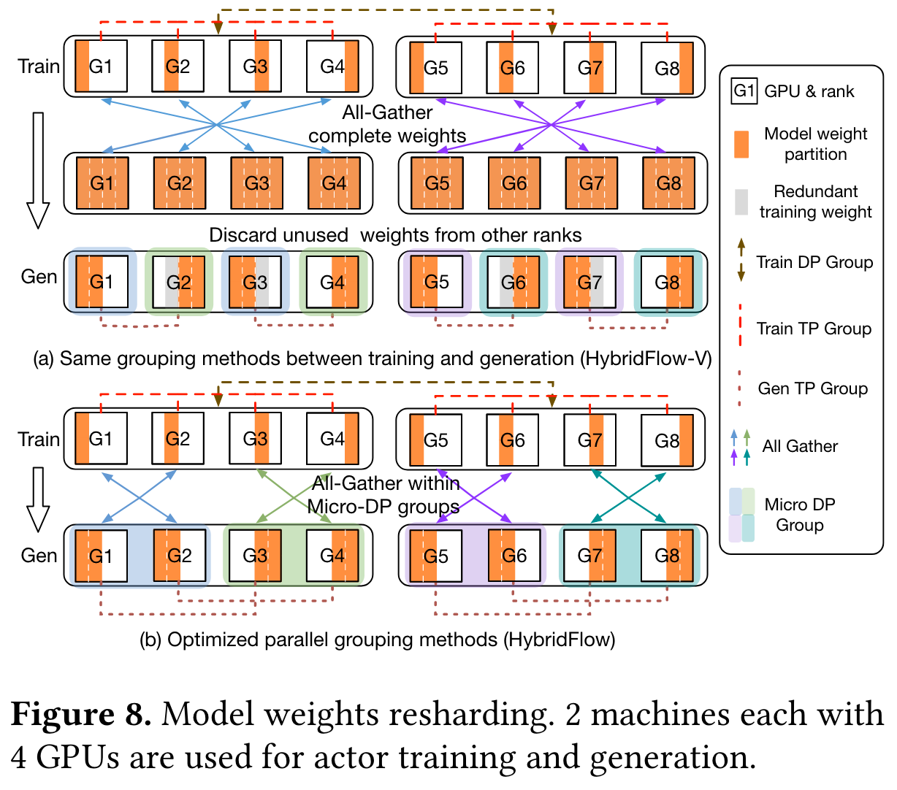
5. 3D-HybridEngine: Zero-Redundancy Model Resharding
Problem with Vanilla Grouping (HybridFlow-V): Standard parallel grouping can lead to memory redundancy when resharding weights between training and generation (some GPUs need separate memory for weights).
HybridFlow's Optimized Grouping for Generation:
Forms generation TP and PP groups by selecting ranks at regular intervals (tg​t​, pg​p​).
Constructs micro DP groups by sequentially assigning ranks.
Benefits:
Ensures overlap between training and generation model weights on each device.
Enables reuse of training weights during generation.
Achieves zero memory redundancy and minimal communication overhead (concurrent all-gathers within micro DP groups).

Slide 18
6. Evaluation Setup
Testbed: Cluster of 16 machines, each with 8 NVIDIA A100-80GB GPUs (128 GPUs total). NVLink 600GB/s, Inter-machine 200Gbps.
Software: CUDA 12.1, PyTorch 2.1.2, Megatron-core 0.6.0, NCCL 2.18.1, vLLM 0.3.1.
Models & Algorithms: Llama models (7B to 70B) for PPO, ReMax, Safe-RLHF algorithms.
Baselines: DeepSpeed-Chat v0.14.0, OpenRLHF v0.2.5, NeMo-Aligner v0.2.0.
Metric: RLHF throughput (tokens/sec).
Dataset: "Dahoas/ful-hh-rlhf".
Hyperparameters: Prompt/response length 1024, global batch size 1024.

Slide 19
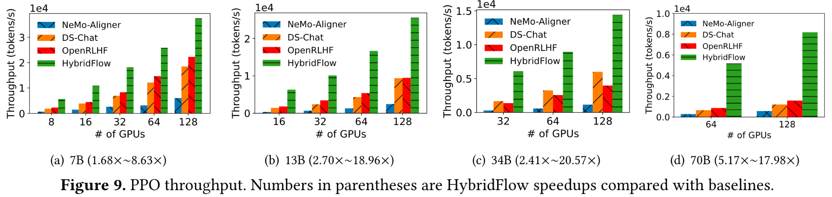
6. Results: End-to-End PPO Throughput
HybridFlow consistently outperforms DeepSpeed-Chat, OpenRLHF, and NeMo-Aligner across all model sizes and GPU counts for PPO.
Average speedups: 3.67x vs DS-Chat (up to 7.84x), 3.25x vs OpenRLHF (up to 5.93x), 12.52x vs NeMo-Aligner (up to 20.57x).
Highest average speedup (9.64x) for 70B models due to reduced transition overhead (up to 71.2% vs DS-Chat, 89.1% vs OpenRLHF).

Slide 20
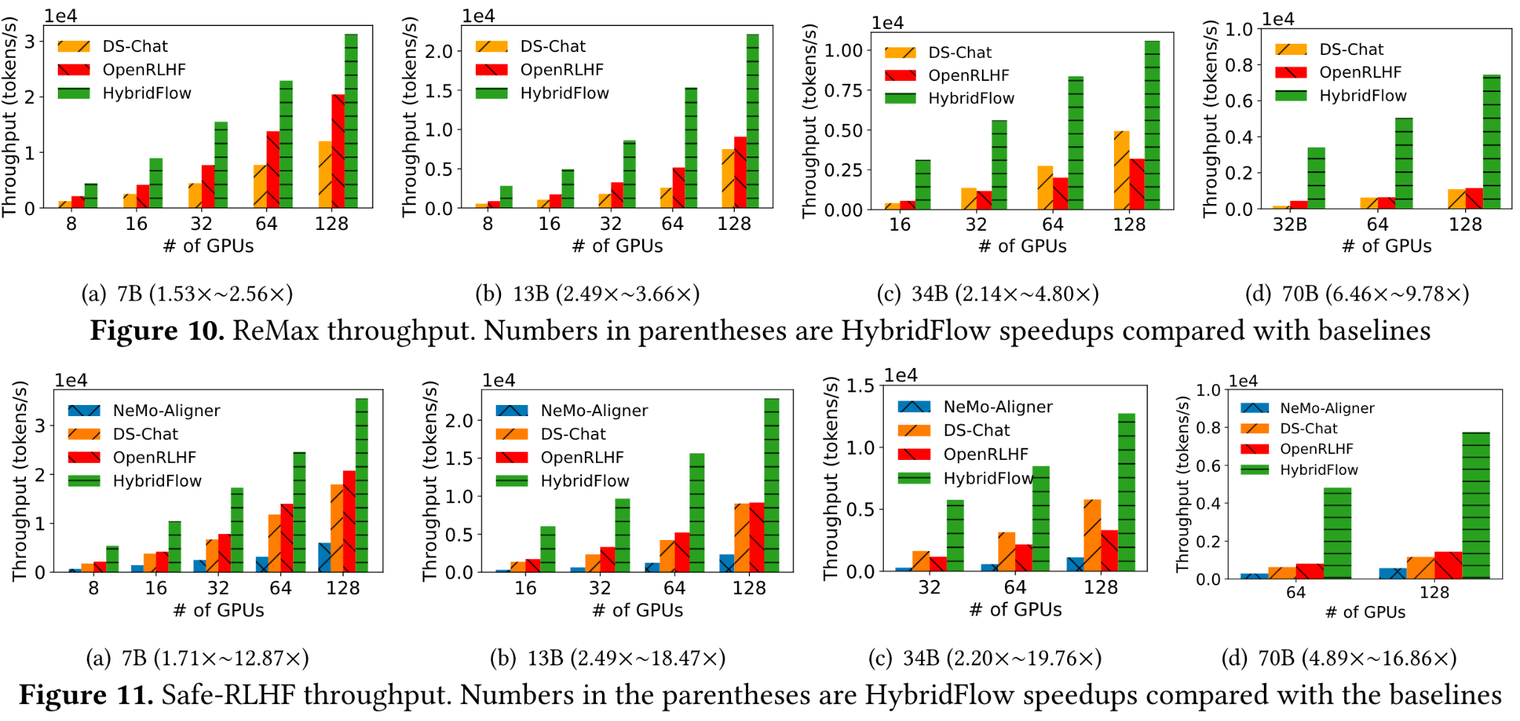
6. Results: End-to-End ReMax and Safe-RLHF Throughput

Slide 21
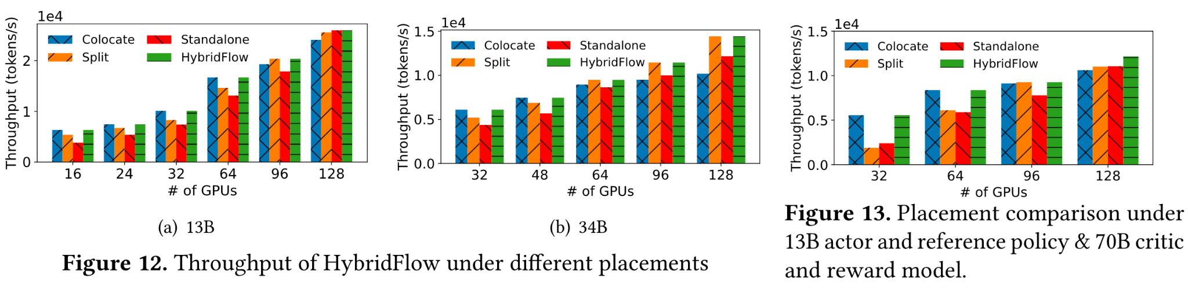
6. Results: Impact of Model Placement (Homogeneous Models)
Figure 12: Evaluated PPO with different placements: colocate (DS-Chat), standalone (OpenRLHF), split (NeMo-Aligner), hybridflow (Algo 1 optimized).
FIgure 13: Scenario: PPO with 13B actor/reference policy and 70B critic/reward models.

Slide 22
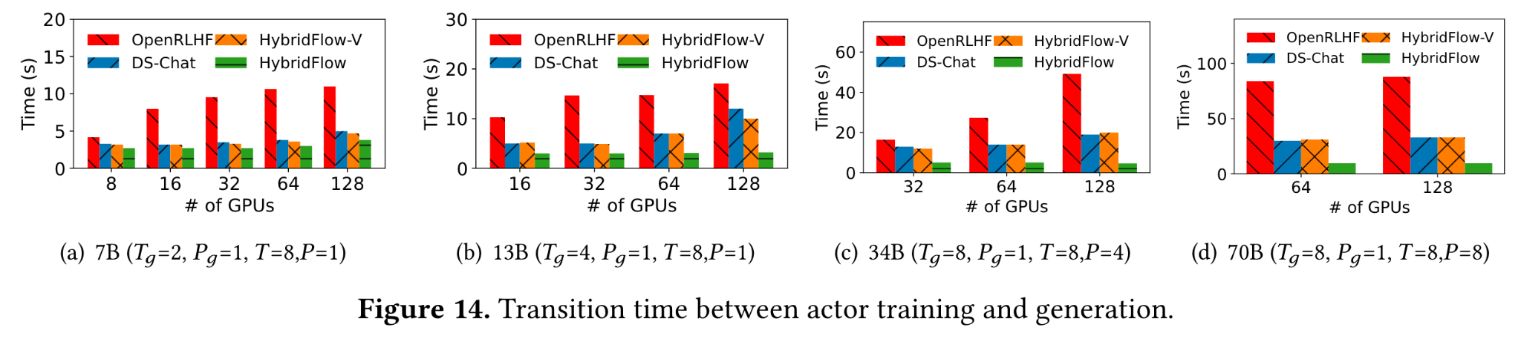
6. Results: 3D-HybridEngine - Actor Transition Time

Slide 23
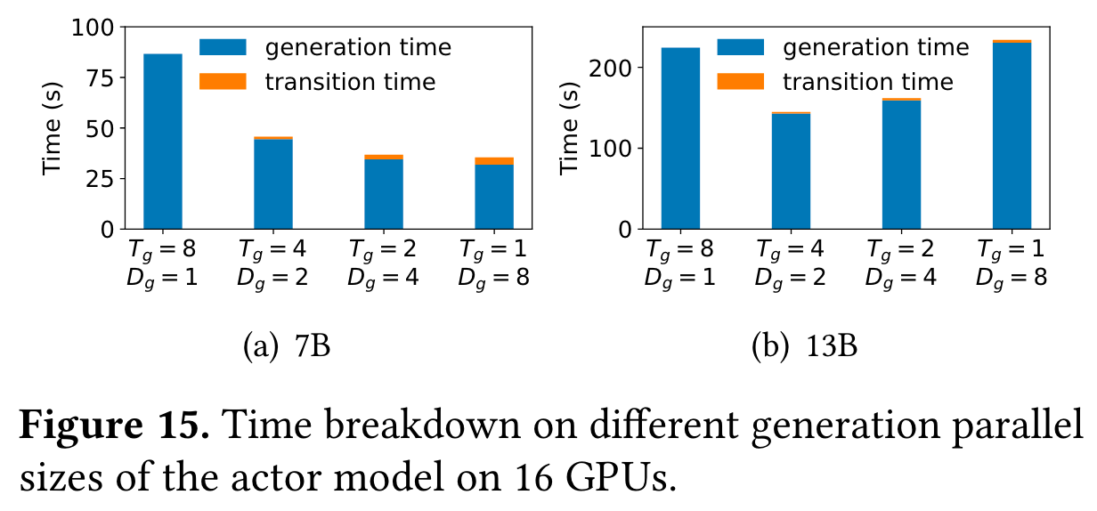
6. Results: 3D-HybridEngine - Transition & Generation Time Breakdown
Validates using different parallel sizes for actor training and generation within HybridFlow.
Experiment: 16 GPUs, training parallelism 1-8-2 (p-t-d), varying generation TP size (tg​).
Using the same TP size as training (tg​=8, NeMo-Aligner approach) results in largest generation latency due to GPU underutilization.
Further reducing tg​ is limited by KVCache per GPU.

Slide 24
7. Discussion
Fault Tolerance: HybridFlow is orthogonal to existing methods, incorporates checkpointing (model states, dataloader IDs, RNG states) coordinated by the single controller. Can employ redundancy-based fault tolerance.
Placement Insights:
Allocate more GPUs to actor (reduces non-parallelizable generation latency).
Co-locate all models on smaller clusters if GPUs fully utilized.
Distribute actor and critic on different devices for large clusters (strong scaling) for parallel execution.
Resource Multiplexing: Currently uses time-sharing for co-located models. Fine-grained GPU sharing and heterogeneous resources are future research.
Beyond Alignment to Reasoning: Framework is adaptable; reward model can be replaced by non-NN modules (e.g., sandbox for code, validator for math) for broader RL tasks.

